Slide 1
Whose Narratives? Regime, Agrarianism,
and Visual Materials
Gatari Surya Kusuma
KUNCI Study Forum & Collective
Bakudapan Food Study Group

Slide 2
“Far from being just about the ‘maintenance of human life’, the purpose of colonial was the commercial exploitation of the land.” Malcolm Ferdinand and Anthony Paul Smith, Decolonial Ecology: Thinking from Caribbean World (2022)

Slide 3
Capital
Material Struggles
Historically contingent relations of production
(Mollona: 2019)

Slide 4
Source: https://poles-marmer-teraso-granit.com/
Marble mining in Besole, Tulungagung, East Java, Indonesia. From the wide angle showed the massiveness but seems no one inhabiting it.

Slide 5
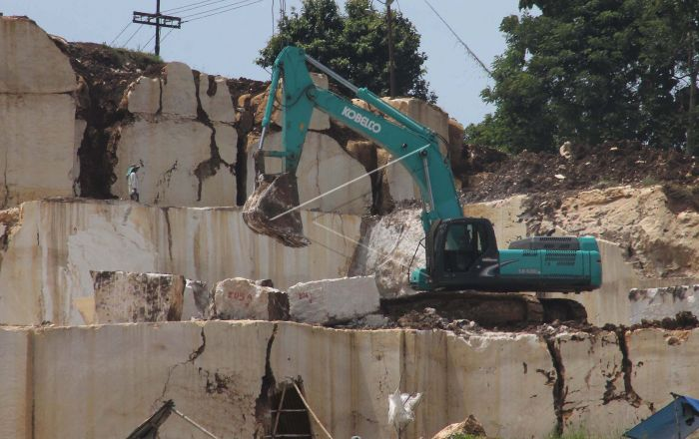
Source: https://poles-marmer-teraso-granit.com/

Slide 6
What are the politics of
representative visual?

Slide 7
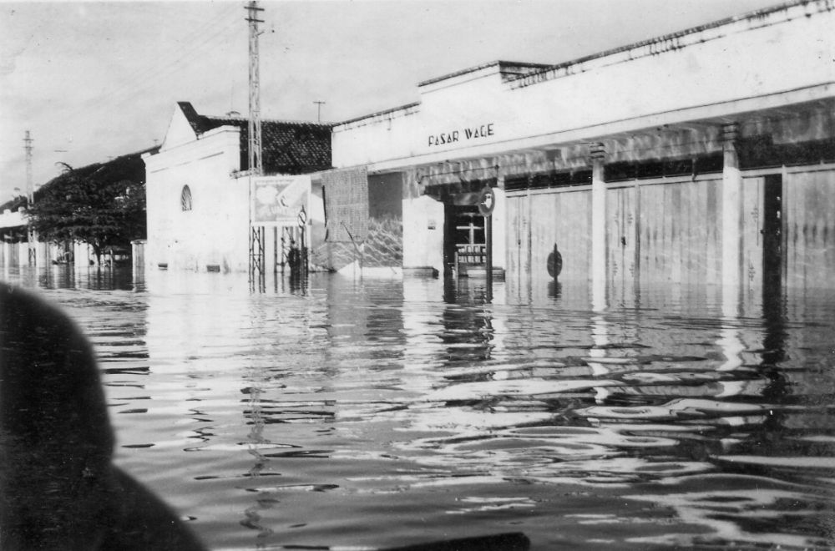

Slide 8
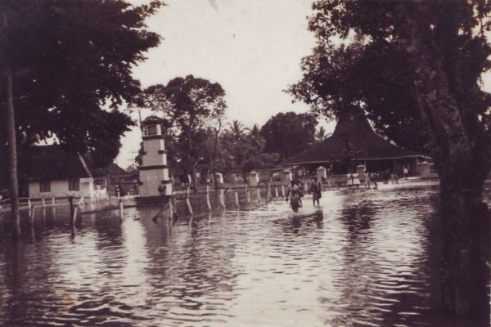
Archived by Catur Tutud Priambodo

Slide 9
How does the fractures of colonialism and
socio ecological injustice enter into visuality?

Slide 10
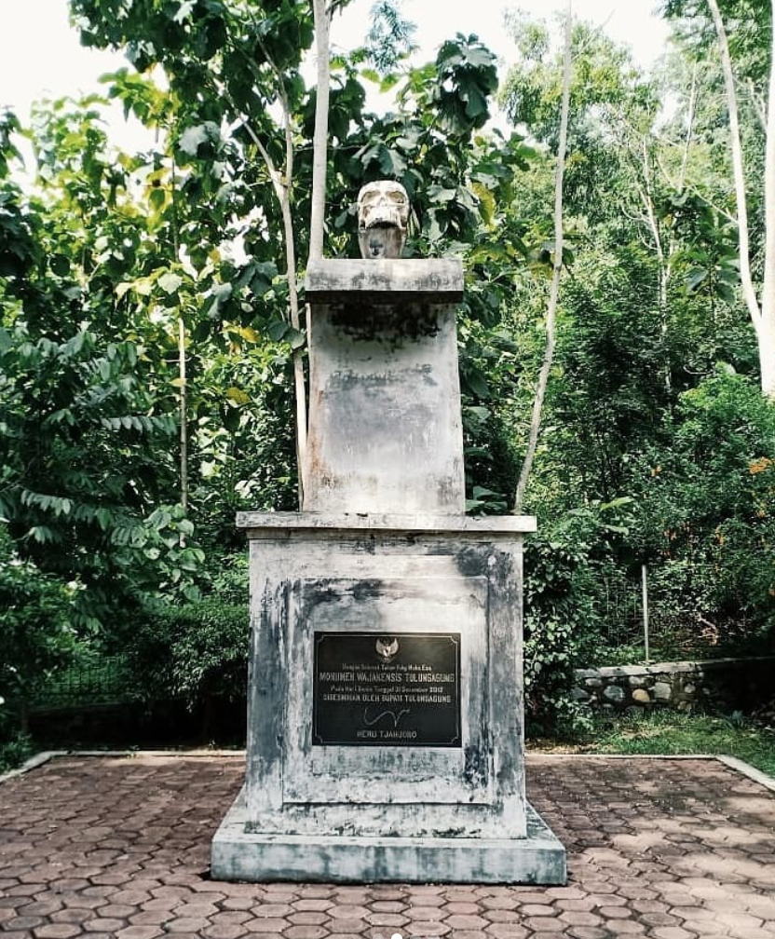
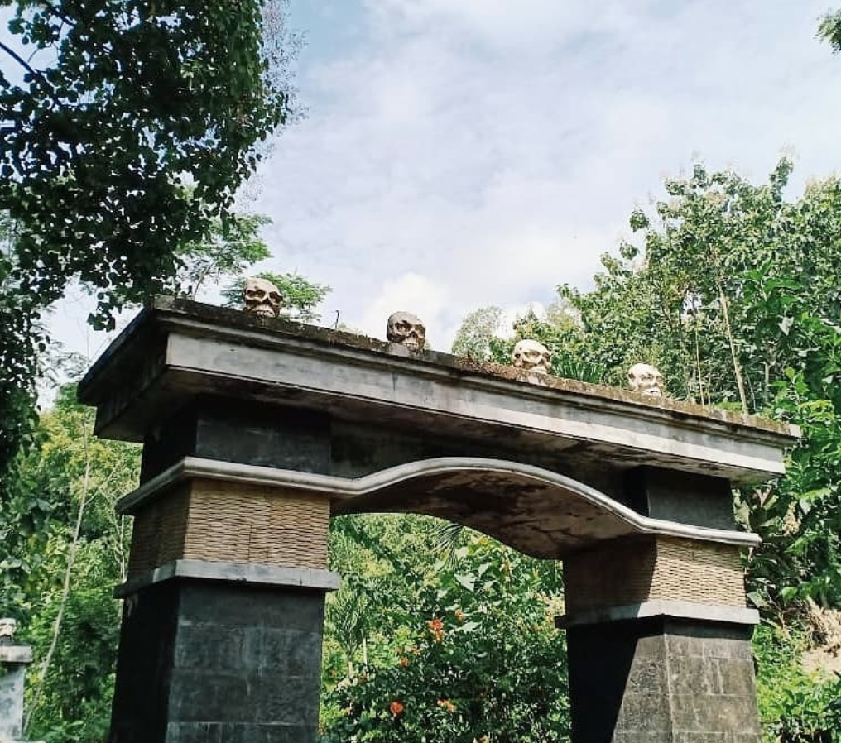
Situs Wajakensis, Tulungagung, East Java

Slide 11
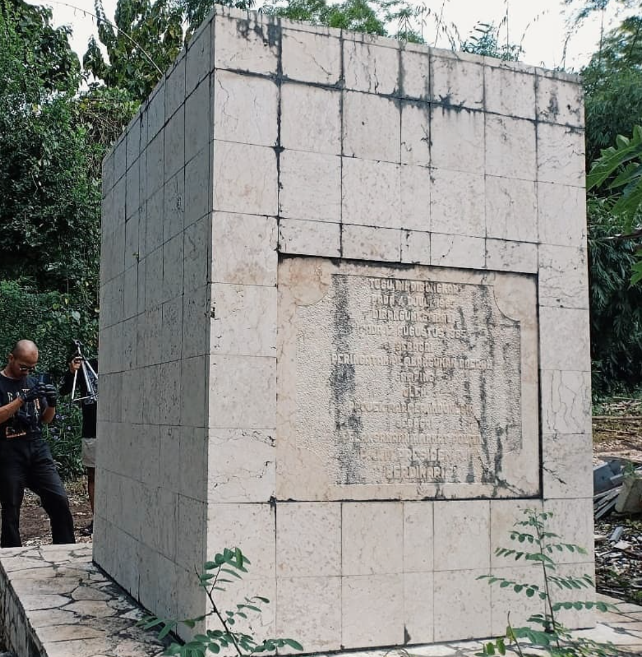
What does the monument
tells us about the past?
The exact and non-negotiable story, desire of belongingness,
‘new’ history (?)

Slide 12
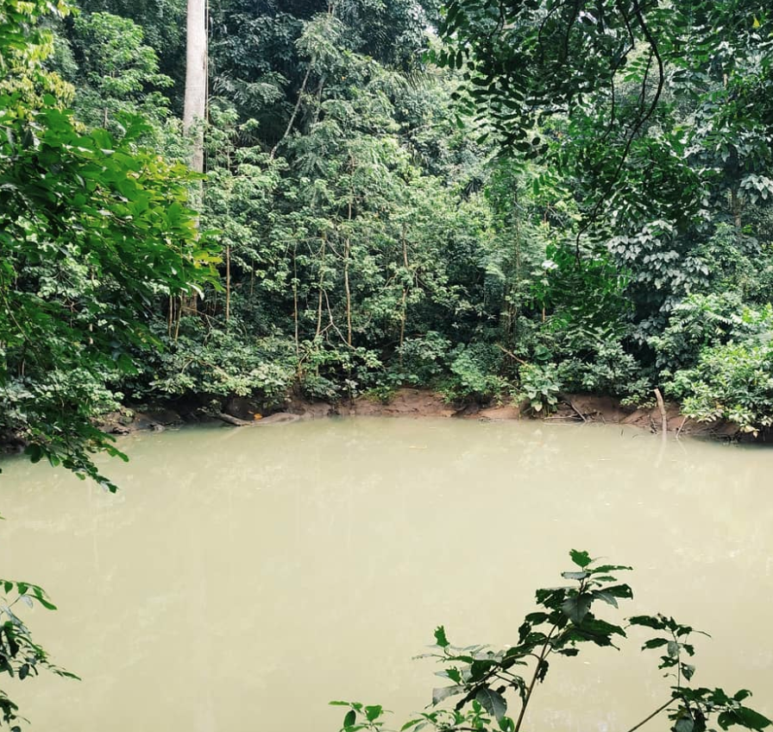
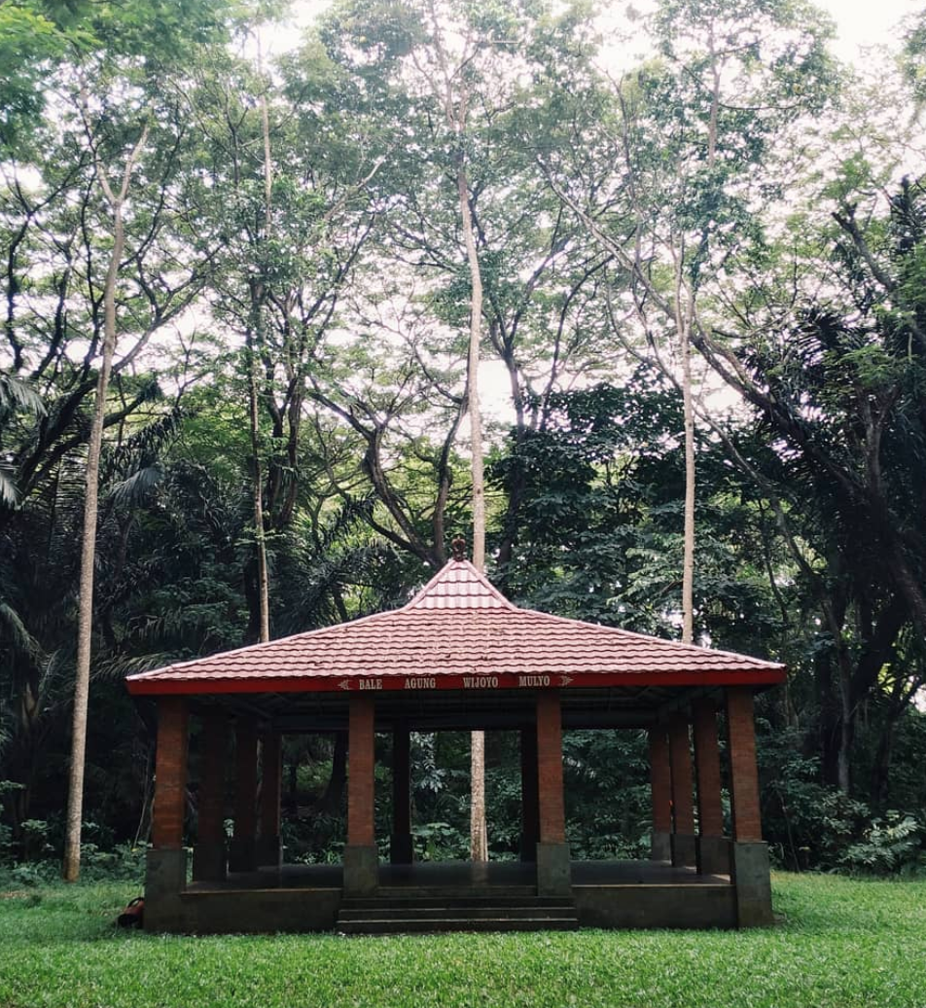
Telaga Buret, Tulungagung, East Java

Slide 13
This swamp triggered some of rituals and holds the local traditional knowledge.
Spiritual animism community as the knowledge holder beyond the modernity belief, capitalism, and materialism, they are working collaboratively with the spirits to be the land guardian

Slide 14
In what position I should take?
How can the archiver untied the desire of collecting?
What can I learn from the way of spirit keeps their land?

